Slide 1
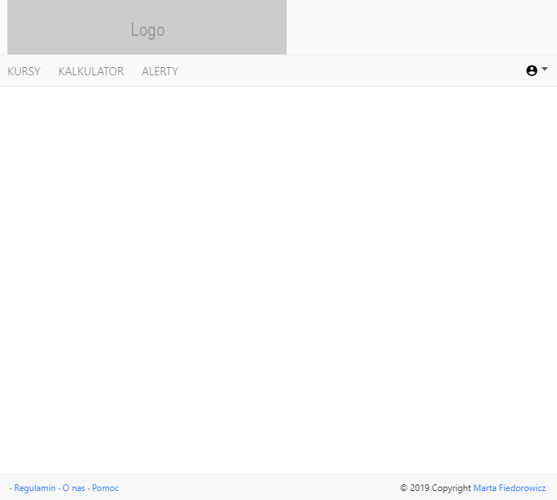
header.component
navbar
navbar dropdown
router-outlet
footer.component

